Slide 1
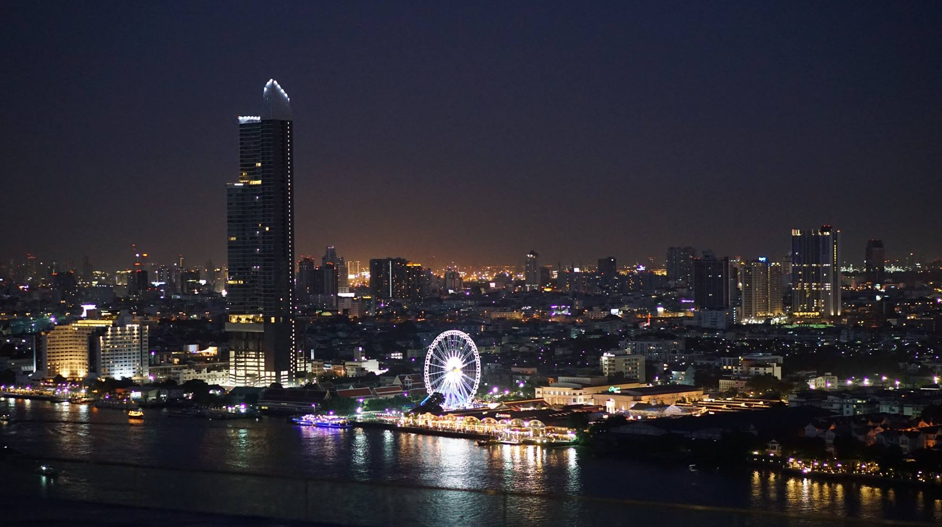
seenrooftopbangkok.com facebook.com/seen.restaurant.bar instagram.com/seenrestaurantbar

Slide 3
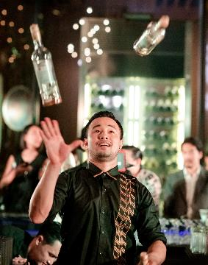
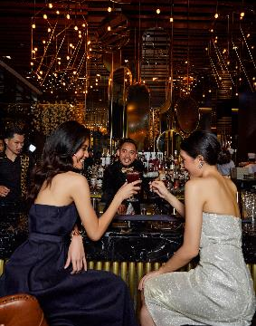
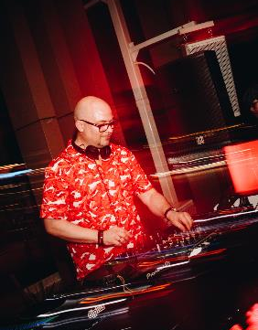
SEEN Restaurant & Bar Bangkok is a multi-storey, multi-sensory playground overlooking the city skyline and Chao Phraya river. A modern Portuguese-Brazilian menu from celebrity chef Olivier da Costa is cooked to perfection and served up by Chef de Cuisine Alexandre Castaldi. Head to the lounge, deck or stunning rooftop for sensual beats by Music Director Scotty B and worldly cocktails our Mixologist.

Slide 4
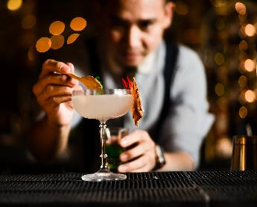
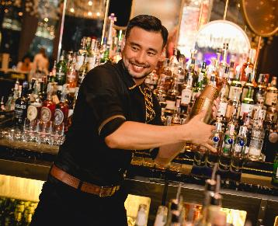
Whimsical cocktail creation
SIP

Slide 5
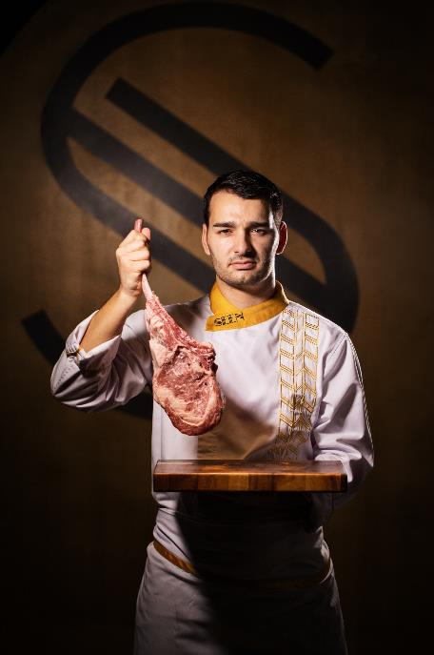
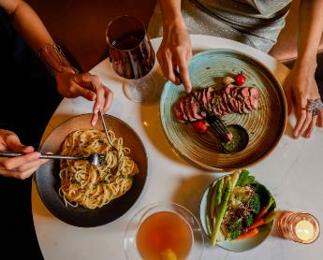
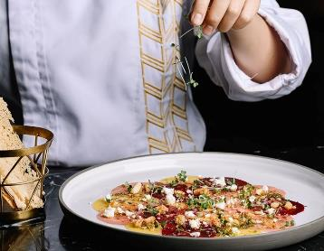
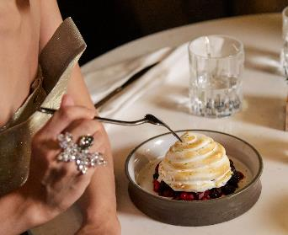
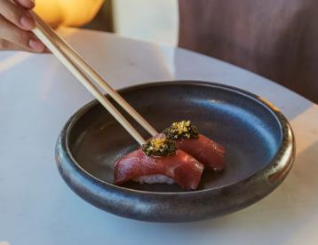
Executive Chef Alexandre Castaldi with crafted menu of fresh
bursting flavours, showcasing the finest cuisines around the world
TASTE

Slide 6
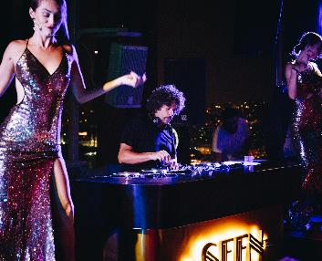
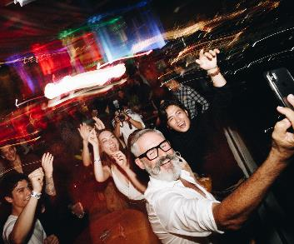
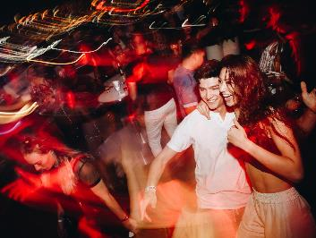
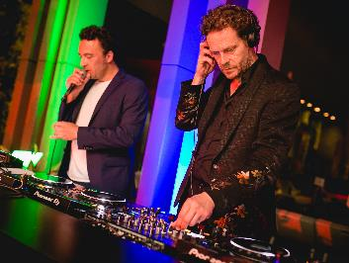
Music Director, Scotty B and artist driven events bring you
on a memorable journey of musical discover
LISTEN

Slide 7
Not just a party but an epic experience
EXPERIENCE

Slide 8
CAPACITY
 | DIMENSION (WxLxH) | SIT DOWN DINNER | STANDING COCKTAIL WITH TABLE | STANDING COCKTAIL WITHOUT TABLE
THE ROOM | 10x12x4.8 m. | 60 guests | 60 guests | 80 guests
THE BAR (BACK BAR) | 10x8x4.8 m. | 15 guests | 15 guests | 40 guests
THE BAR (FRONT BAR) | 10x13.5x4.8 m. | 50 guests | 50 guests | 80 guests
THE GARDEN | 7x12x9 m. | 70 guests | 70 guests | 120 guests
26TH FLOOR | 37x45.5x4.8 m. | 180 guests | 180 guests | 350 guests
THE VIEW | 10x21x10 m. | - | 60 guests | 180 - 200 guests

Slide 9
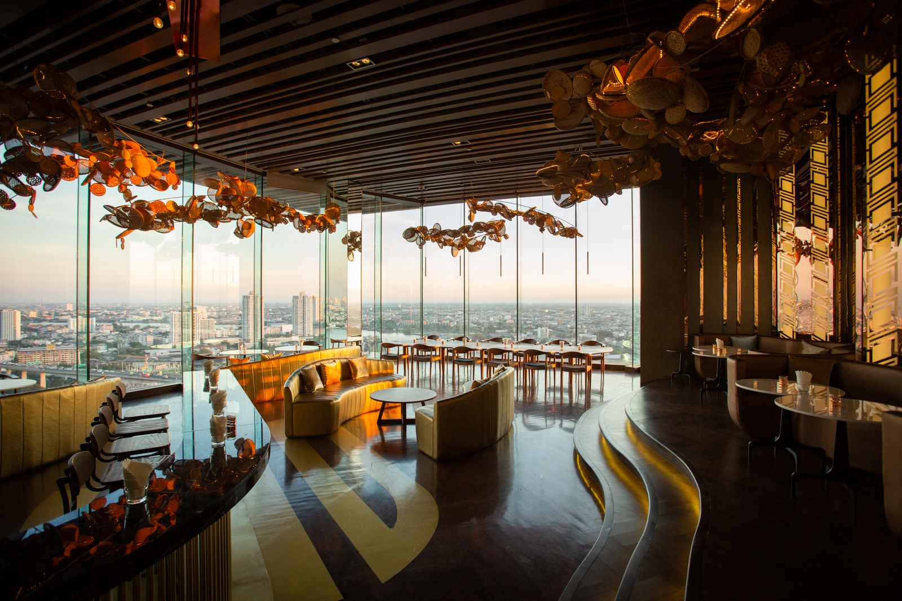
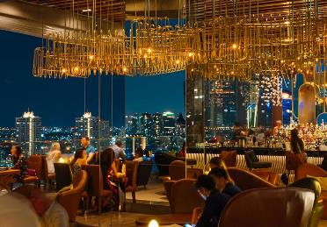
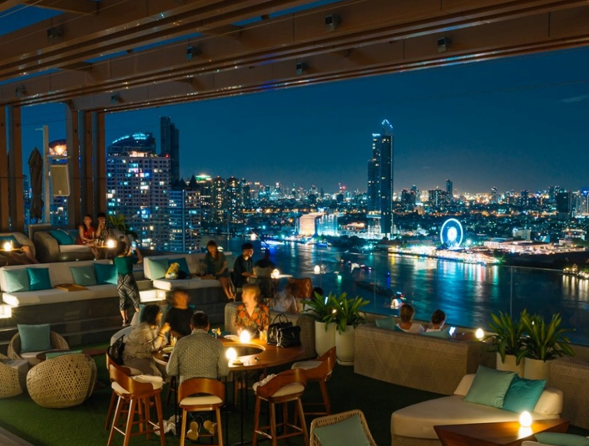
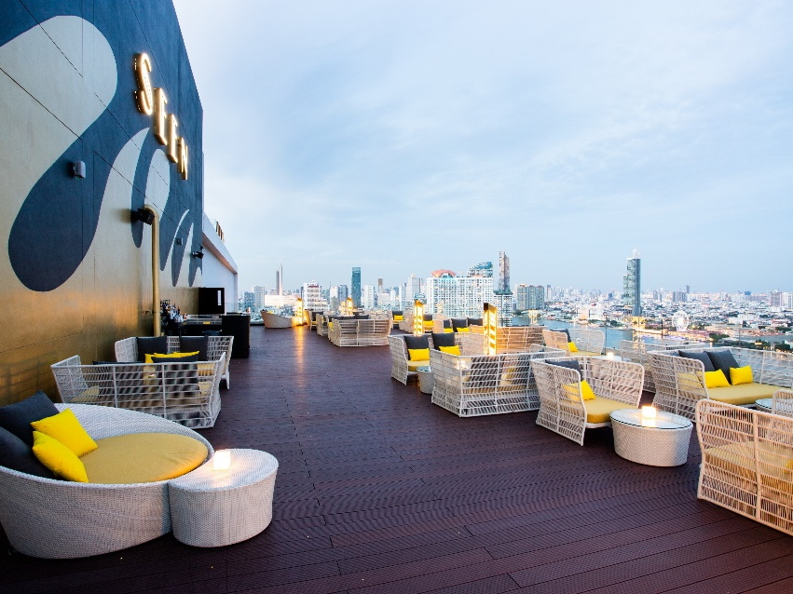
SPACE TO BE SEEN
THE BAR
THE ROOM
THE GARDEN
THE VIEW

